Slide 1
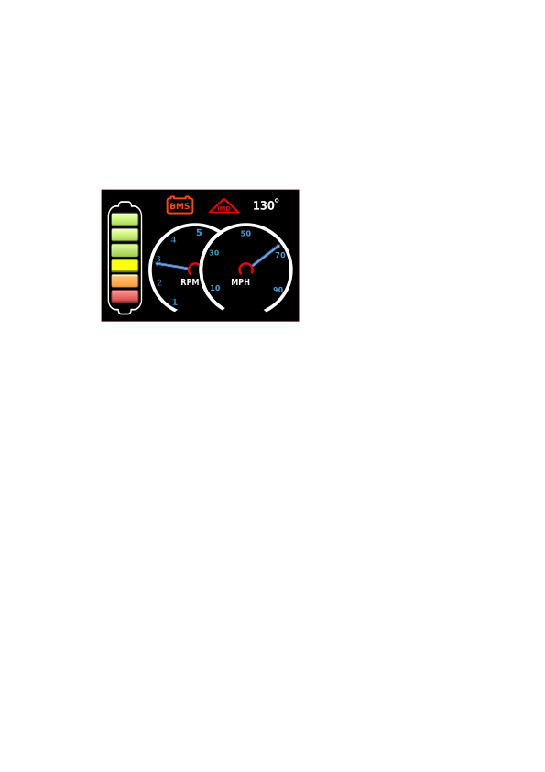
Flashing warnings symbols will indicate errors in BMS, and IMD System.
Temperature indicator for motor or controller.
Battery meter will indicate voltages between safe and critical levels.
Proposed - Display GUI Layout
RPM & MPH display, or other optional data can be substituted.

